Slide 1

Identifying High
Quality Leads
By: A.Partida

Slide 2
Introduction
BrewMasters Coffee Catering provides gourmet coffee bars for events.
As bookings increase, manual lead sorting has slowed responses.
High-value clients face delays while low-value inquiries clog the workflow, causing missed opportunities and team frustration.

Slide 3
Identified Problems
Manual lead reviews consume hours each week.
Sales staff copy form data into spreadsheets.
“Hot” leads (corporate, repeat, premium) are missed or delayed.
Low-budget or unclear leads overwhelm the system.

Slide 4
Solution Overview
Automation connects BrewMasters’ form to n8n.
AI scores each lead and updates Google Sheets automatically.
High-value leads trigger instant Gmail alerts for faster follow-up.
Manual review handles low-budget or unclear leads.
→ Result: faster responses, efficient prioritization, and scalable growth.

Slide 5
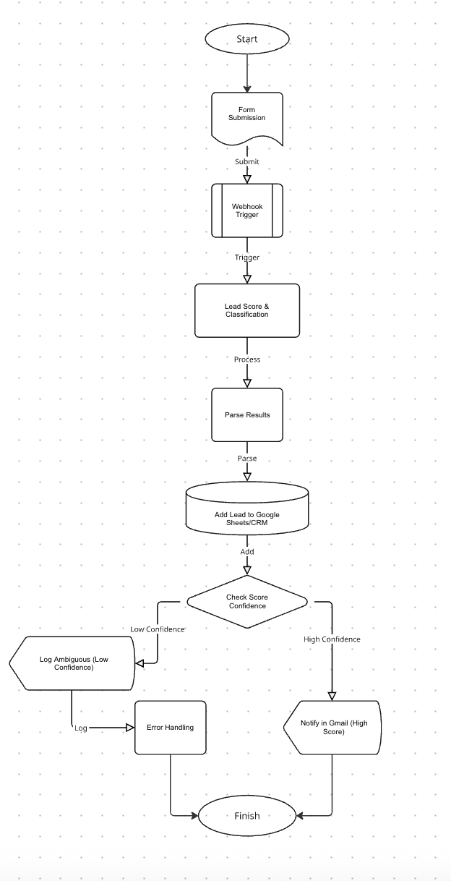
Automation Diagram
→ Start → start process
→ Form Submission → capture lead data
→ Webhook Trigger → send to workflow
→ Lead Scoring → AI LLM assign value
→ Parse Results → extract fields/change code language
→ Add to Sheets/CRM → store lead info
→ Check Confidence → evaluate score
→ Low → Log & Handle Error
→ High → Notify in Gmail
→ Finish → end process

Slide 6
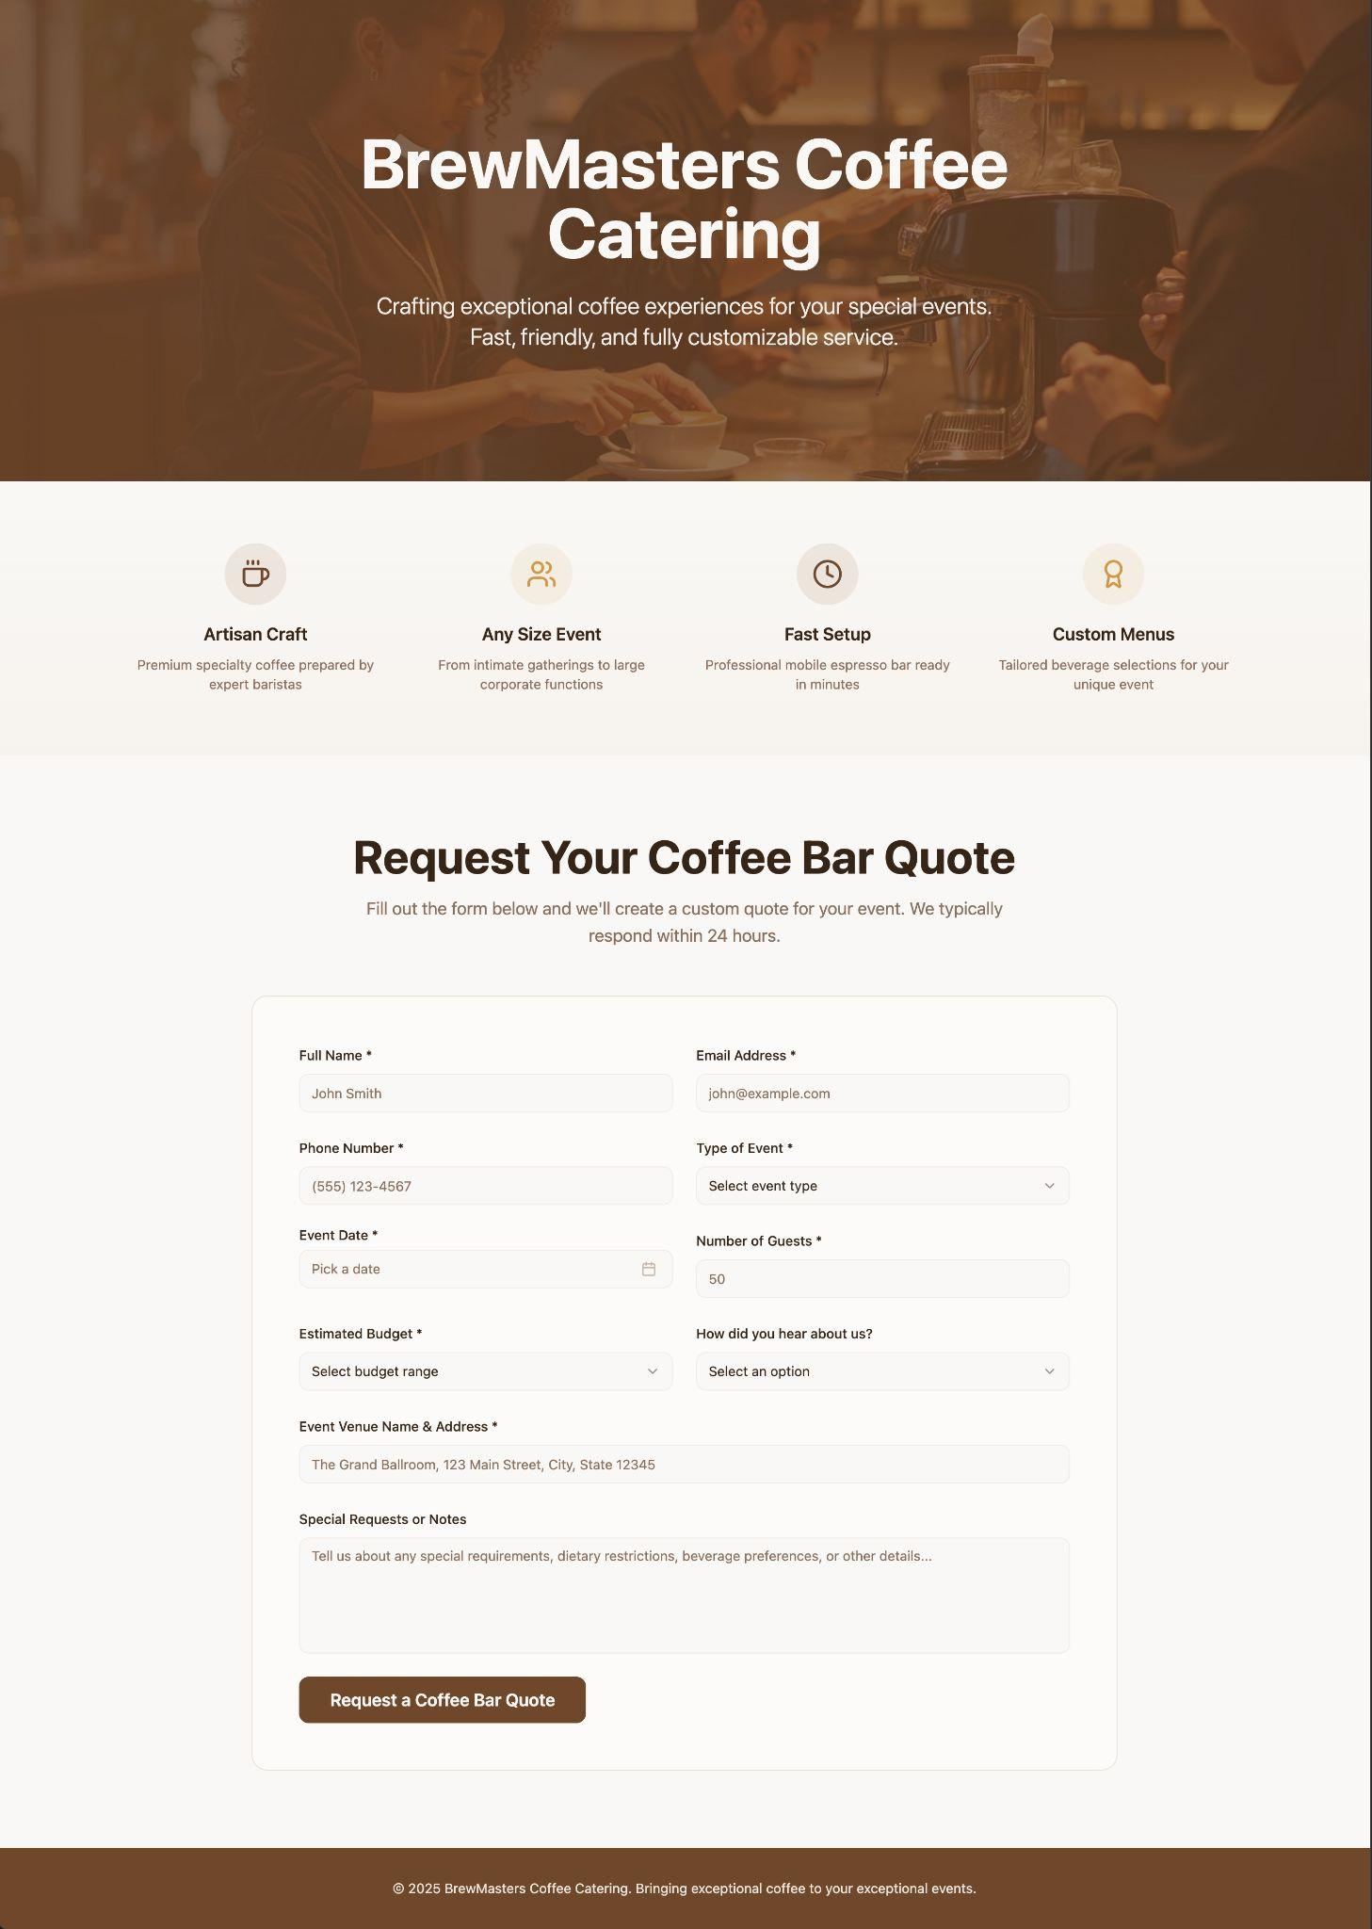
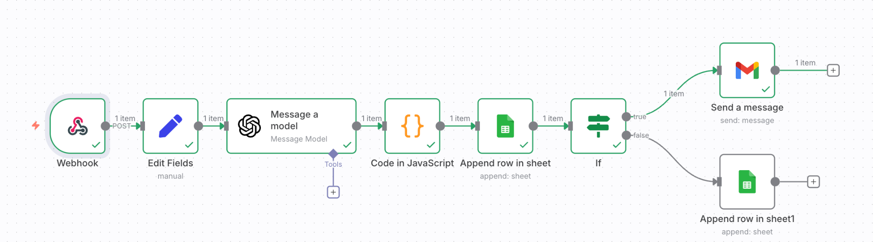
Workflow/Automation
LANDING PAGE TO COLLECT FIELDS AND TRIGGER WEBHOOK
COMPLETE WORKFLOW IN N8N

Slide 7
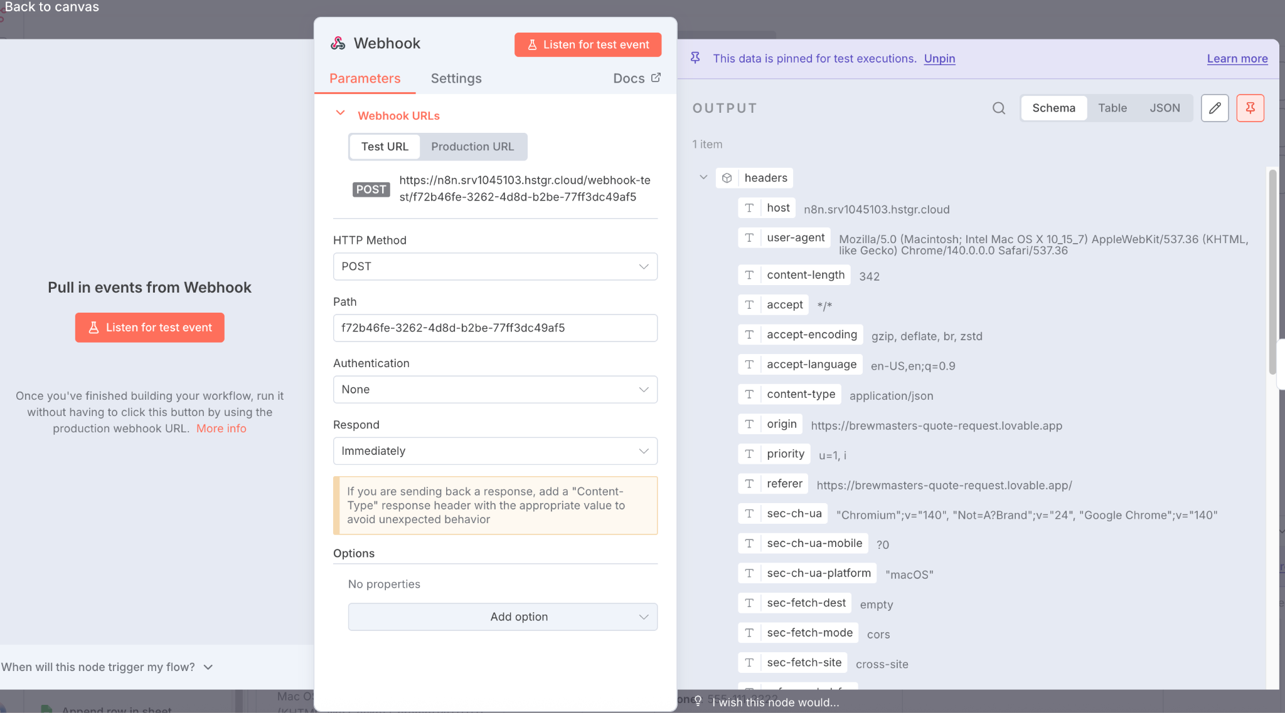
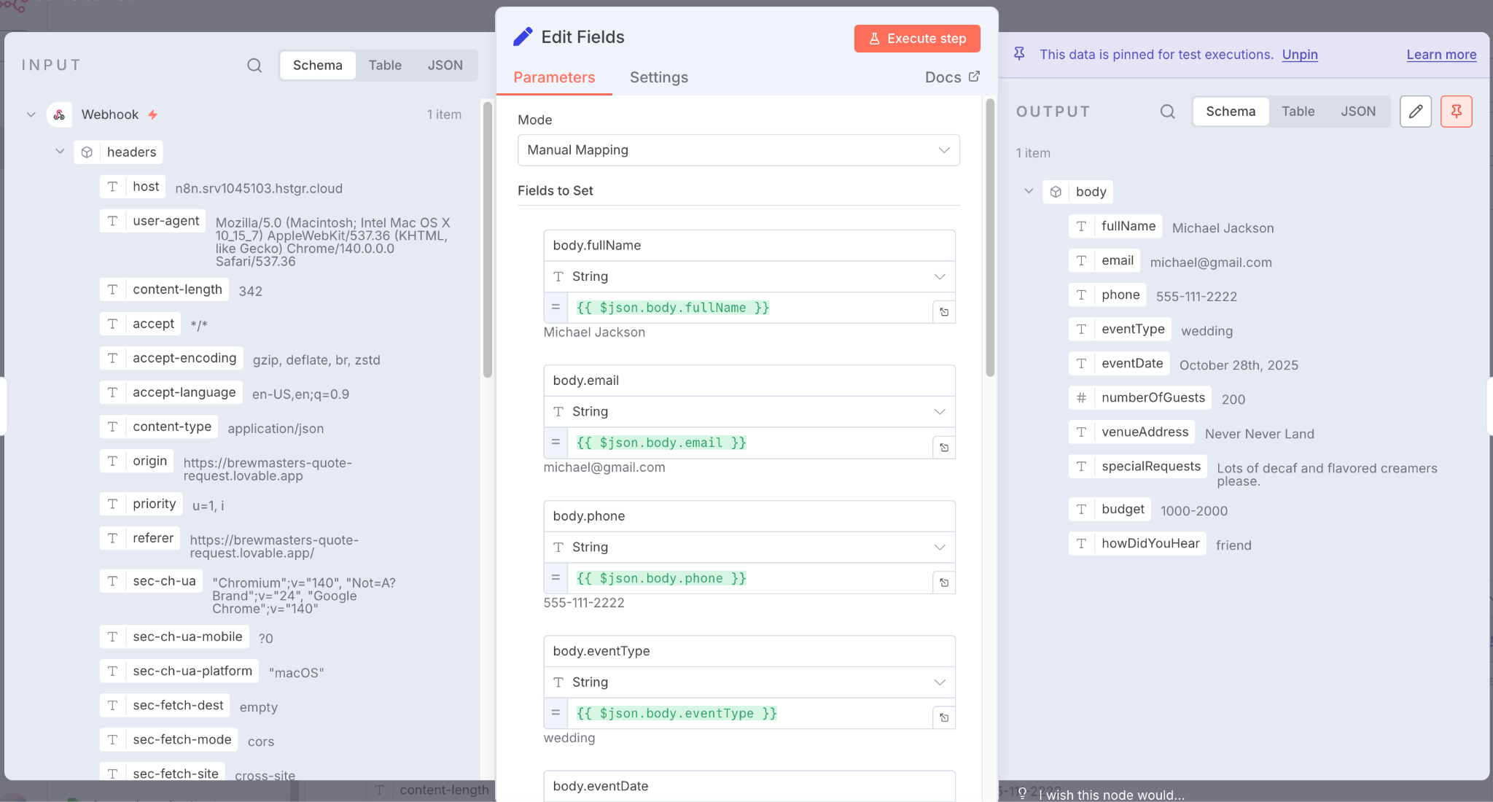
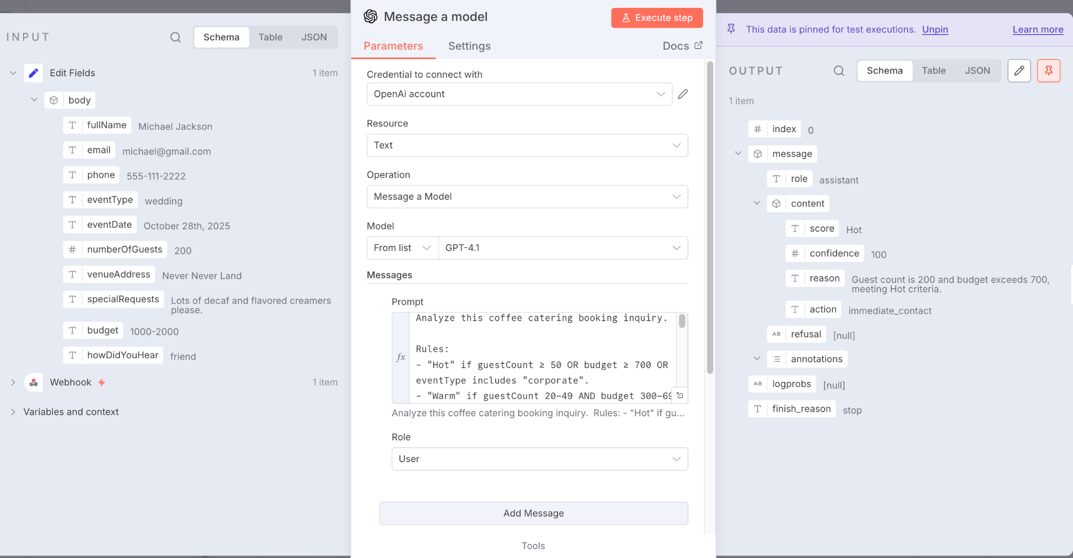
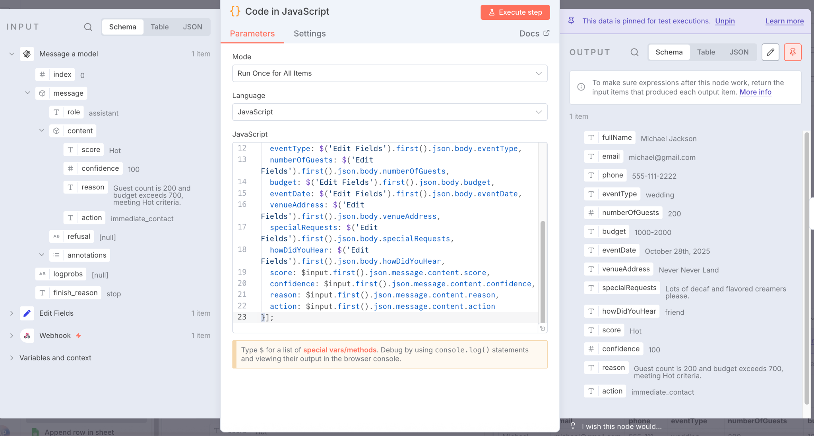
CONFIGURATIONS- IN/OUTPUTS
WEBHOOK NODE
EDIT FIELD NODE
AI GEN NODE
CODE NODE

Slide 8
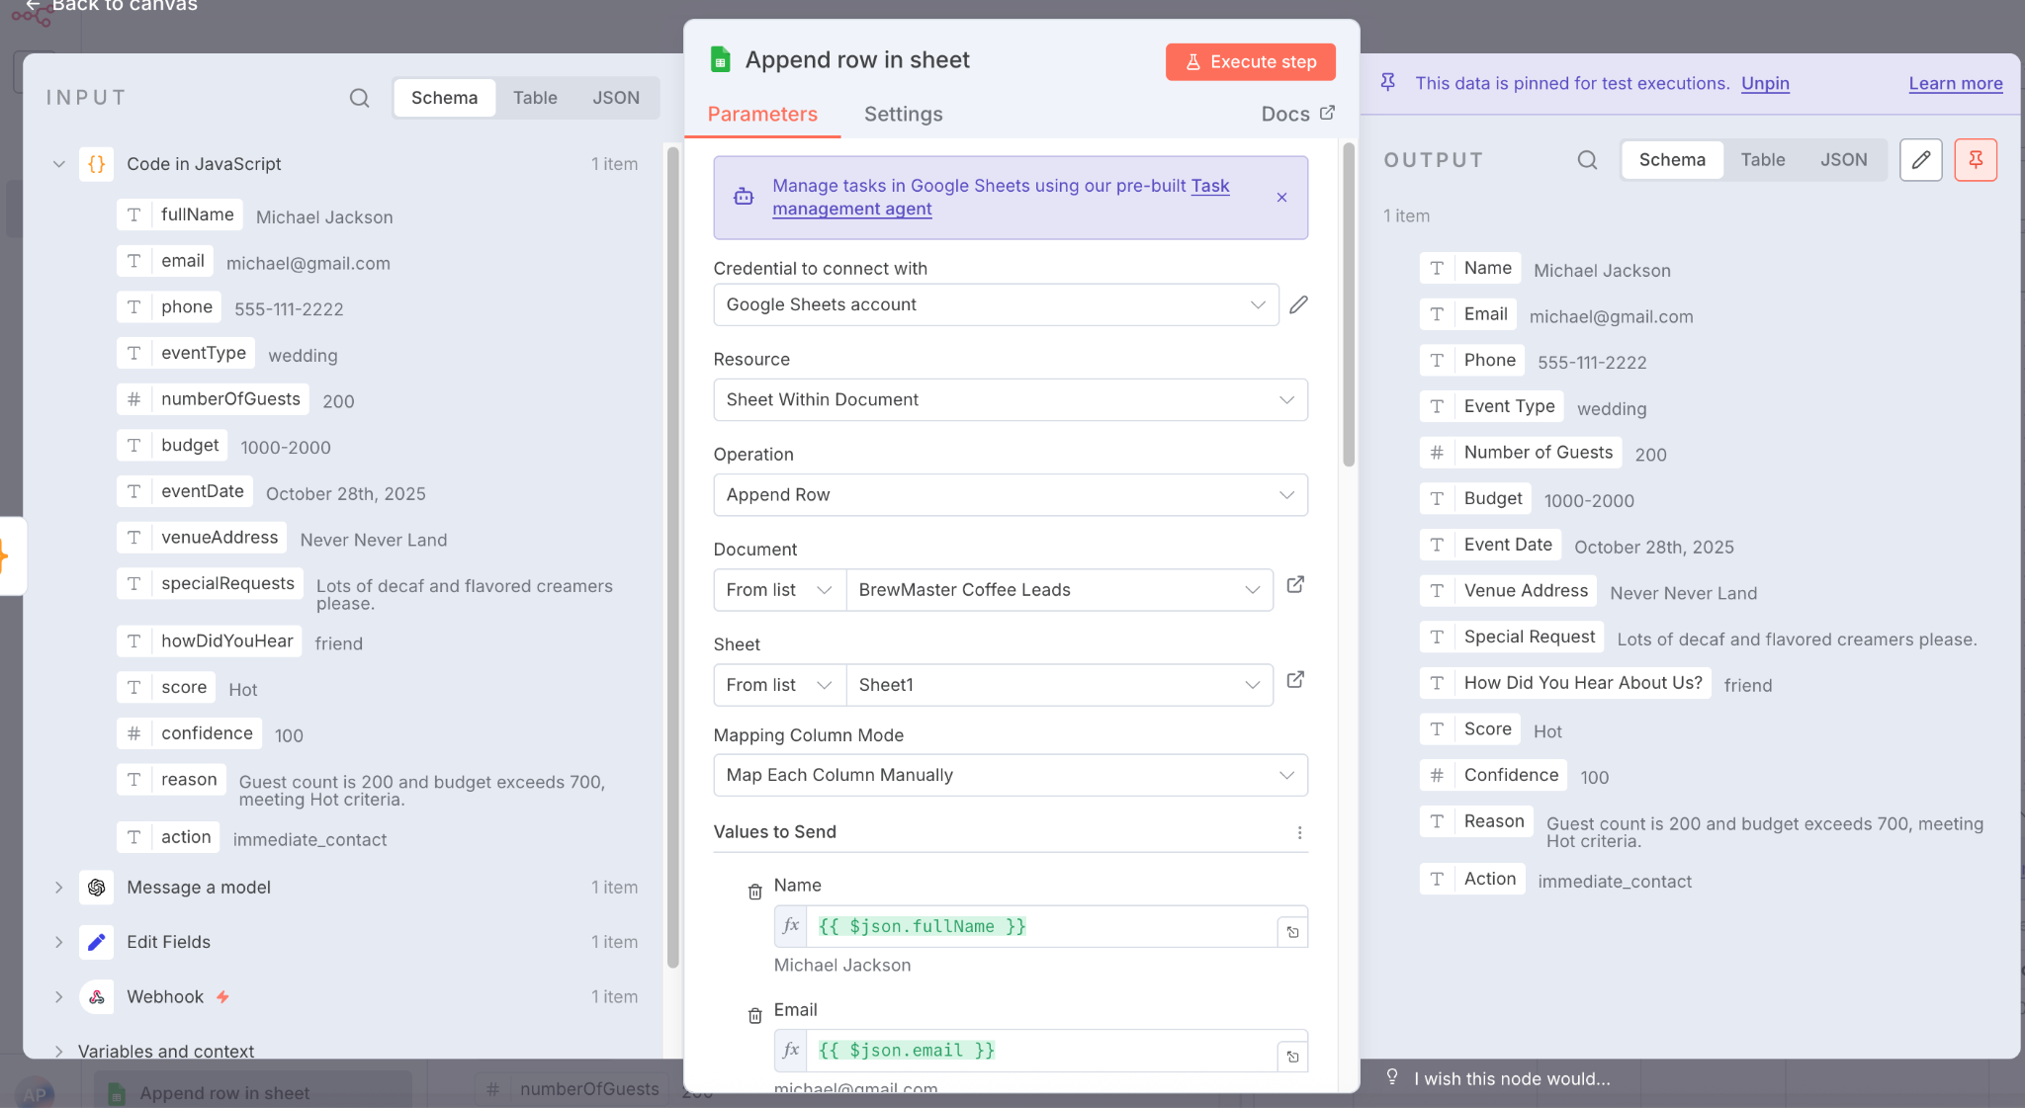
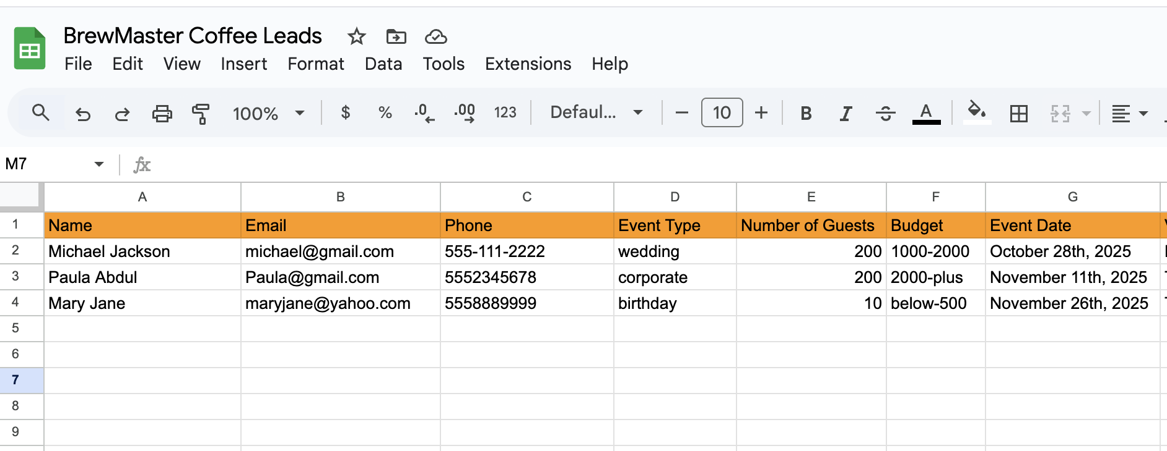
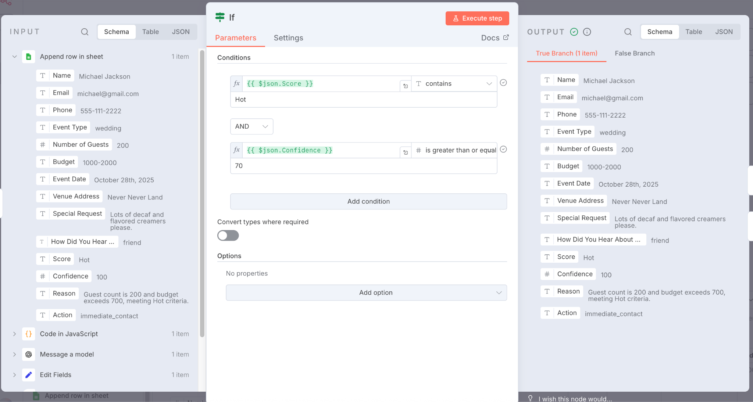
Workflow/Automation
GOOGLE SHEET
NODE
(ALL CLIENTS GET LOGGED IN GOOGLE SHEETS HERE)
IF NODE

Slide 9
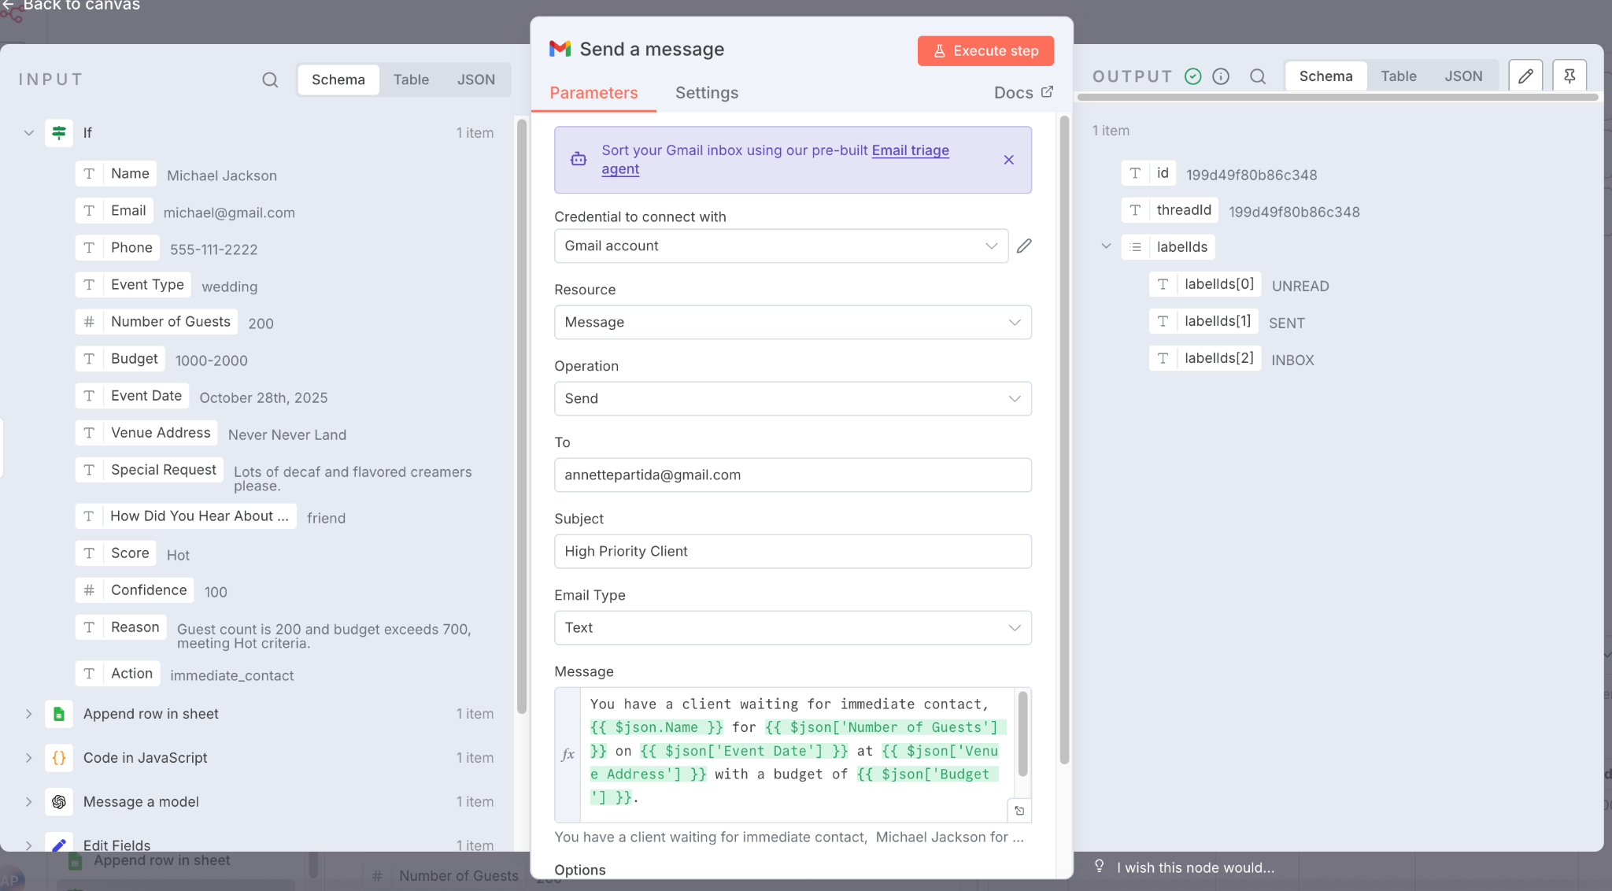
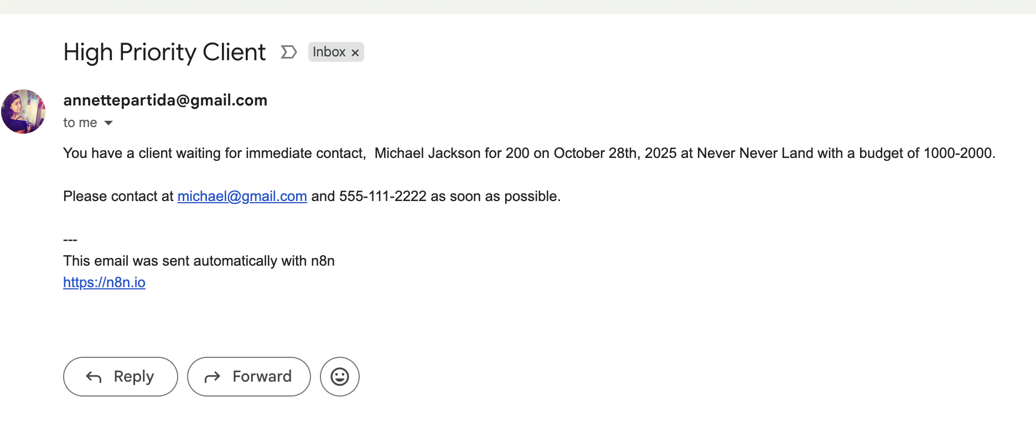
Workflow/Automation
IF CONDITION IS TRUE, CLIENT RECEIVES HIGH VALUE CUSTOMER ALERT IN GMAIL IMMEDIATELY

Slide 10
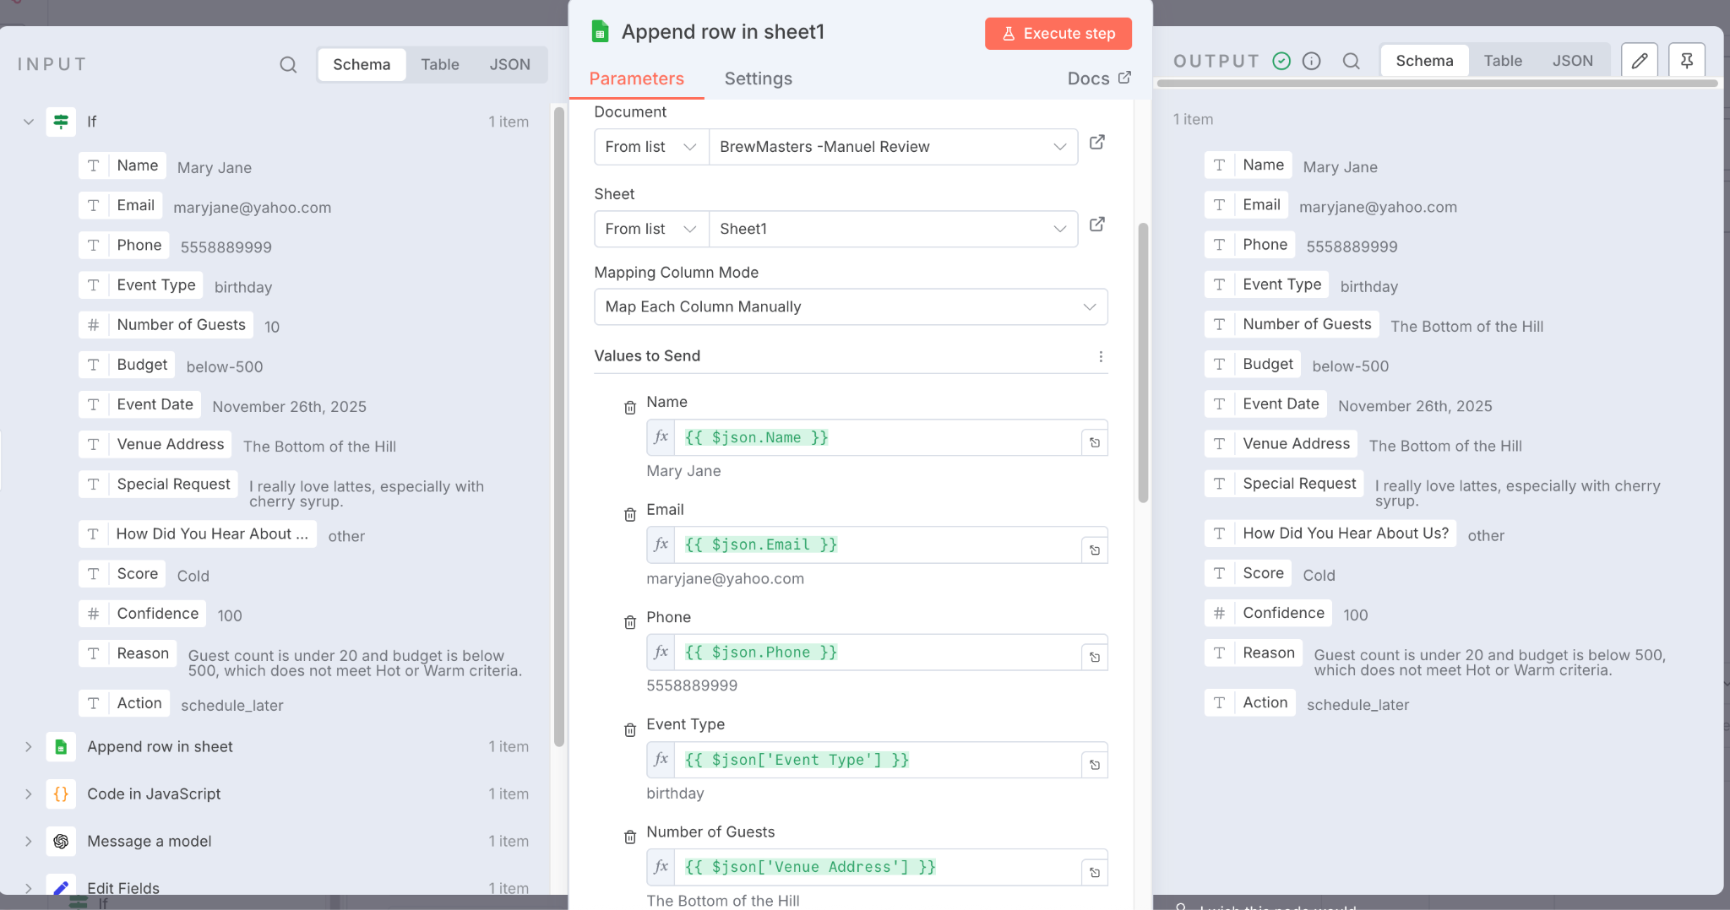
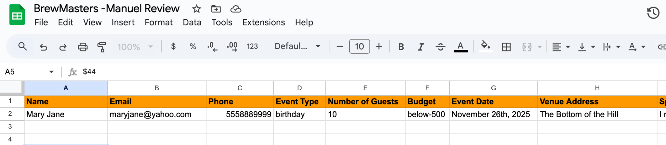
Workflow/Automation
IF CONDITION IS FALSE, LOW BUDGET OR UNCLEAR LEADS APPEND IN A MANUAL REVIEW SHEET FOR CLIENT TO REVIEW AT THEIR CONVENIENCE

Slide 11
What I learned:
How to capture website form submissions in n8n using a webhook.
The importance of normalizing and mapping form fields with the Edit Fields node.
Using an AI classification node to score leads and returning structured JSON.
Writing a small JavaScript snippet to merge AI output with the original data.
Appending structured data to a Google Sheet and triggering notifications based on lead quality.
Navigating OAuth setup for Google APIs and understanding the difference between testing and production credentials.

Slide 12
What was challenging:
Identifying the correct node type when n8n changed the “Function” node to “Code”.
Parsing JSON returned by the AI node and referencing the right nodes in expressions.
Dealing with Google’s “Access blocked” error because the OAuth client wasn’t verified.
Setting up conditional logic to route hot leads immediately while retaining others for manual review.

Slide 13
How to improve for the next automation:
Plan the data schema and field mappings before building the flow.
Check Google integrations before building automation to avoid OAuth verification hurdles.
Better understand functions for parsing and classification to simplify future workflows.
Store API keys and secrets in environment variables to make the workflow more secure and portable.
Independently explore new n8n features, such as more advanced conditional nodes or native AI integrations, to reduce wasting time during work.

Slide 14
Thank you!
I would like to thank the entire TripleTen administration, tech support, and tutors (Steve, Rodrigo, Ran, Leonardo) for their endless support and encouragement.
I am excited to continue my journey forward with AI Automation.
-Annette

